Slide 1
EXECUTIVE REPORT
Traffic Volume Analysis
Four-junction hourly flow study • November 2015 – June 2017
Prepared for Executive stakeholders Date April 22, 2026
Notes:
Opening slide. Set expectation: four-junction hourly traffic study covering 20 months, analyzing volume patterns and building a short-term forecast. Four headline findings and concrete recommendations follow.

Slide 2
OVERVIEW
At a glance
48,120
20 months
4
Hourly observations
Nov 2015 – Jun 2017
Junctions monitored
Junction 1 dominates
Averages 45 vehicles/hr — roughly 3× Junctions 2 & 3 and 6× Junction 4. Accounts for 56 % of total volume.
Predictable daily rhythm
Weekday peaks late-morning and 6–8 p.m.; weekend volumes roughly 25 % below weekday baseline.
Volumes are rising
Daily totals at Junction 1 grew steadily across 2015–2017; calendar year is the 2nd strongest driver in the model.
96.5 % model accuracy
Random Forest predicts hourly volume with ±2.4-vehicle mean error — fit for signal-timing and staffing use.
Traffic Volume Analysis | Executive Deck
2 / 7
Notes:
Quick overview. Dataset is 48,120 clean hourly rows across 4 junctions over 20 months. The four takeaways — Junction 1 dominates volume, traffic is predictable, it's growing, and a model is ready — frame the rest of the deck. Each takeaway gets its own slide next.

Slide 3
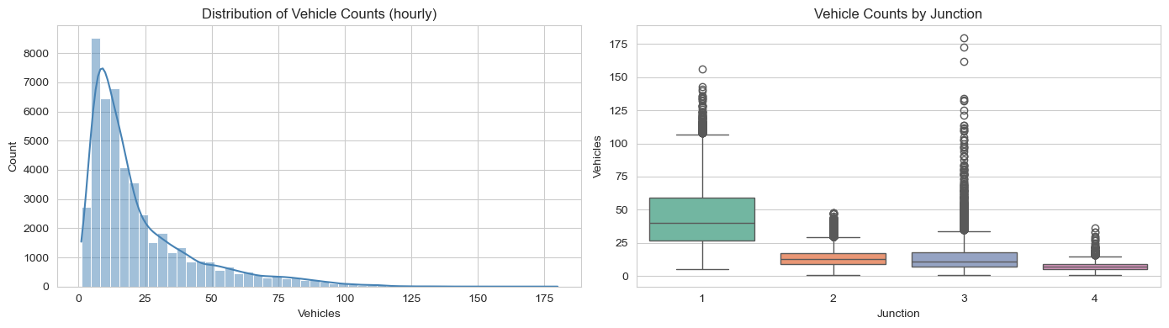
FINDING 1
Junction 1 carries most of the load
56%
of total hourly volume comes from Junction 1
Junction 1 45.1 avg vehicles/hr
Figure 1 — Hourly distribution (left) and vehicle counts by junction (right).
Junction 2 14.3 avg vehicles/hr
Junction 3 13.7 avg vehicles/hr
Why this matters
Junction 4 7.3 avg vehicles/hr
Any congestion or capacity intervention should start at Junction 1 — it drives the majority of observed load, and Junction 3 shows rare but extreme spikes (up to 180 vehicles/hr) that deserve a closer look.
Traffic Volume Analysis | Executive Deck
3 / 7
Notes:
Key point: volume is lopsided. Junction 1 averages 45 vehicles per hour against 7.3 at Junction 4. If you only have budget for one intervention, start here. Also flag Junction 3 — low average but rare spikes up to 180 vehicles that warrant an incident-response look.

Slide 4
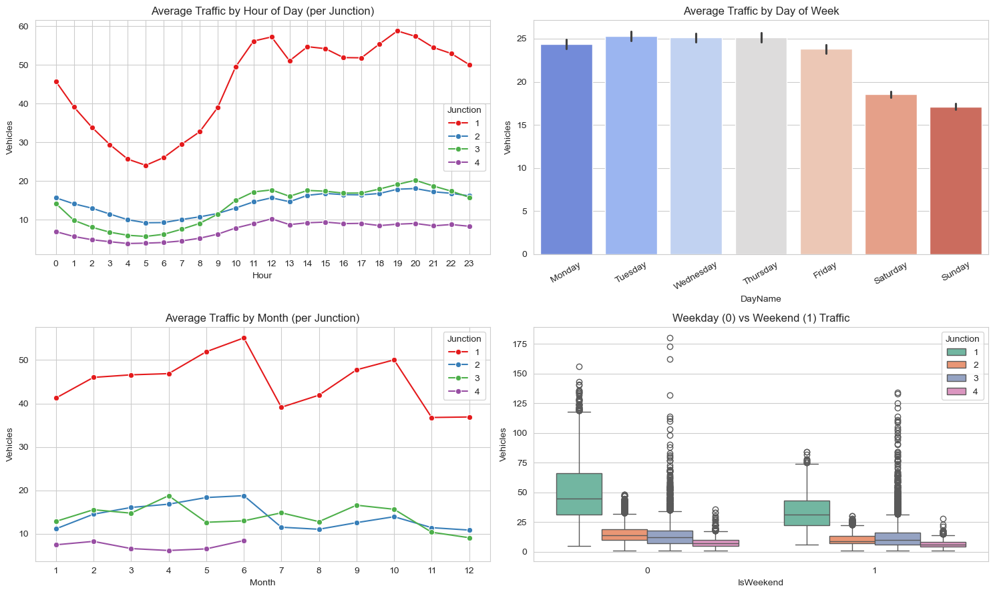
FINDING 2
Traffic follows a predictable daily and weekly rhythm
Weekday pattern
Volume climbs from a 4–5 a.m. trough to a late-morning plateau, dips mid-afternoon, then peaks again 6–8 p.m.
Weekend drop
Saturday and Sunday averages sit ~25 % below the Monday–Friday baseline.
Seasonal note
Junction 1 shows an autumn surge (Sep–Oct); smaller junctions stay flat year-round.
Figure 2 — Average traffic by hour, day, month, and weekend vs. weekday.
Traffic Volume Analysis | Executive Deck
4 / 7
Notes:
Traffic is highly regular. Same daily shape every weekday, same weekend dip, same seasonal bump. That regularity is what makes short-term forecasting feasible — we'll see the model on slide 6. Practical use: you can plan signal timing against these curves with high confidence.

Slide 5
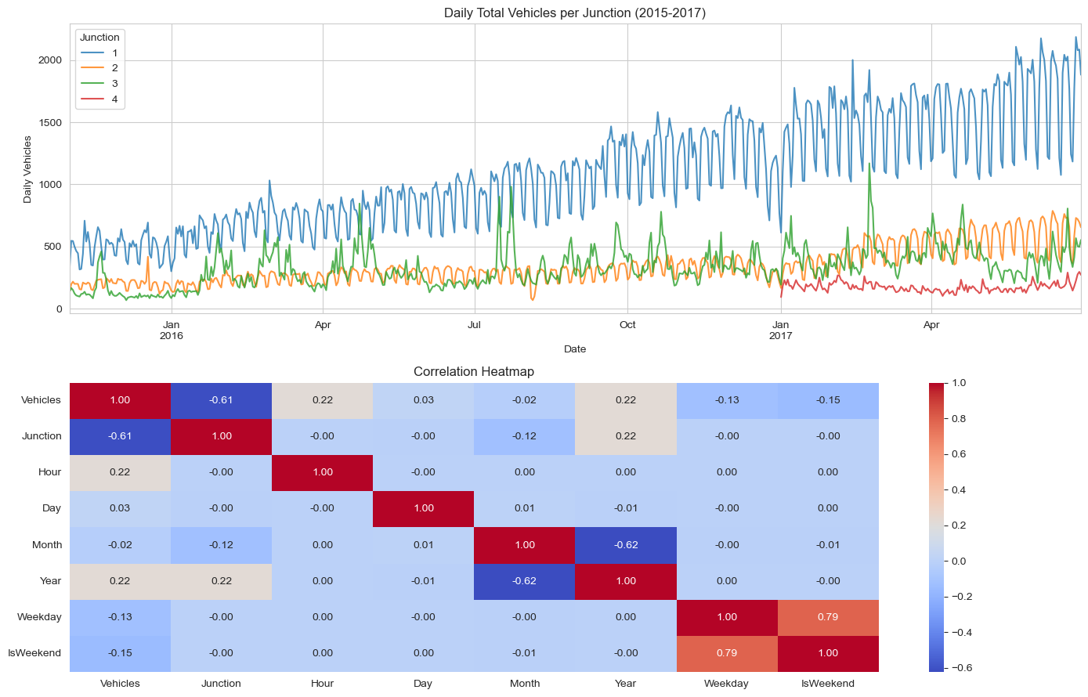
FINDING 3
Volumes are growing, led by Junction 1
Clear upward trend
Junction 1's daily totals climb steadily from late 2015 into mid-2017, while Junctions 2–4 remain broadly flat.
Confirmed by the model
The Random Forest ranks calendar year as the second most important predictor (16 %) — a genuine growth signal, not seasonal noise.
Figure 3 — Daily vehicle totals per junction (top) and feature correlations (bottom).
Traffic Volume Analysis | Executive Deck
5 / 7
Notes:
The growth isn't uniform — it's concentrated at Junction 1. That has implications for any forecasting: the model needs regular retraining, and capacity planning at Junction 1 should assume demand keeps climbing.

Slide 6
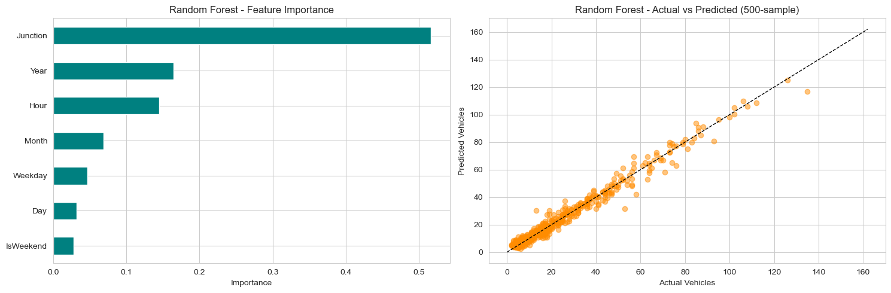
FINDING 4
A forecasting model is ready for operational use
Model | MAE | RMSE | R²
Linear Regression | 9.57 | 12.88 | 0.613
Random Forest (selected) | 2.44 | 3.85 | 0.965
R² = 0.965
Figure 4 — Feature importance (left) and actual vs. predicted vehicles (right).
±2.4 vehicles mean error per hour
What drives the prediction
Junction 52 % • Year 16 % • Hour 14 %
Day-of-week and weekend flags add little once hour and month are known — a useful simplification for any downstream tool.
Traffic Volume Analysis | Executive Deck
6 / 7
Notes:
Two models fitted on an 80/20 split. Random Forest crushes the linear baseline. R-squared of 0.965 and MAE of 2.4 vehicles is tight enough for real operational use — signal timing, staffing rotations, incident response. Caveat: feature importance shows Junction and Year dominate, so we need to retrain periodically as the Junction 1 trend evolves.

Slide 7
NEXT STEPS
Recommendations
01
Prioritise Junction 1 for intervention
02
Put the model into operational use
It drives most of observed load and shows the steepest year-over-year growth.
±2.4-vehicle hourly error is suitable for signal timing, staffing, and short-horizon planning.
03
Recalibrate quarterly
04
Extend the dataset
Because year is a top predictor, the model will drift as traffic grows; quarterly retraining keeps accuracy stable.
Adding weather, holidays, and event calendars would likely reduce residual error and improve handling of unusual days.
Prepared from Traffic analysis.ipynb • April 22, 2026
7 / 7
Notes:
Four recommendations: start with Junction 1, productionise the model, recalibrate on a quarterly cadence, and extend the dataset with weather/events/holidays. Happy to go deeper on any of these in Q&A.

